Slide 1
Poster Design
Valcour Didacts Series
2013

Slide 2
The Purpose of a Poster
Make your research widely available
Effectively summarize research
Interest others in your research
Promote discussion
Notes:
Posters can go where you can’t. Your poster is your representative, and can reach wider audiences than a paper alone—conferences, classrooms, etc.
If your communication is effective, a person reading your poster should be able to tell the subject and purpose within 20 seconds. If they can’t, redesign the poster.
If your poster is interesting/ intriguing, it will draw the attention of colleagues etc. Not only can this open up channels of discussion, it can also serve as an advertisement for you as a researcher.

Slide 3
The Purpose of a Poster
NOT to reproduce your work verbatim
NOT to provide all the details of your work
NOT to be used simply as a visual aid
Notes:
This isn’t a journal paper reproduced on poster board. You’re going to need to pick the most important data to be represented. You probably can’t include all of it. Neither is it a collection of all the graphs and visuals of your paper. You’re not necessarily going to be presenting it, so it should be able to stand on its own as an effective summary of your research. Someone reading this should not be able to reproduce your experiment on their own without reading the paper, but they should have enough information to understand it and relate what it’s about to others.

Slide 4
How?
Notes:
So how do you take these concepts and apply them to your own poster, so that it is clear, informative, and interesting? Answer: proper design principles!

Slide 5
Design: Why It’s Important
First impression
Eye-catching, aesthetically pleasing
Good design → good communication
Notes:
If a poster isn’t eye-catching—if it doesn’t present something novel, interesting or pretty within the first few seconds—it’s not going to be read. Remember that one of the most common places posters are presented is a scientific conference, where there will be hundreds of other posters vying for attention. It doesn’t matter, in that context, how much work you’ve put into your research or how important it is. If it’s unreadable, you aren’t getting your ideas across.

Slide 6
Design Guidelines
Logical flow
White space is valuable
Avoid clashing colors
Primary colors are often problematic
Use no more than 3 different colors
Don’t use dark backgrounds
Notes:
You should not have to number your sections for the reader to know how to read your poster. The logical flow of the poster should be immediately apparent, both through spacing and headings.
This goes back to what a poster is not—it’s okay not to have every single data point on your poster. Leaving blank space allows for a clean, uncluttered look, and makes the available information easier to read. If you include all your data, none of it will be read, so decide what’s important.
Speaking of readability, while colors can help make your poster interesting, they can easily make it an eyesore. Don’t use colors for their own sake—use them only if they will improve the overall look and readability of your poster. Limiting yourself to three non-primary colors can help avoid clashes. In general, avoid red and green-based color schemes, as these can be difficult to read for the color impaired. Dark backgrounds are usually more trouble than they’re worth—the font color has to be reversed, your graphs are often less visible, and they’re much more expensive to print.

Slide 7
Design Guidelines
Replace text with images whenever possible
Use large, clean graphs and tables
Use sans serif for headings and serif for body text
Notes:
4. To re-emphasize: this is a visual medium. You can use images creatively, in ways you can’t in a paper. Take advantage of this freedom. Examples will follow.
5. Grid lines, weird background colors, useless keys: all these are to be avoided. Axis titles and labels should be as large as body text, if possible. 6. Serif is designed to be easier to read for smaller font, so use it for your body text. Examples include Times New Roman, Garamond, and Palatino. Sans serif is bolder and stands out more, which makes it ideal for headings and titles but more straining to read as body text. Examples include Ariel, Helvetica, and Calibri (the 2007-onward default font for Word, for some reason).

Slide 8
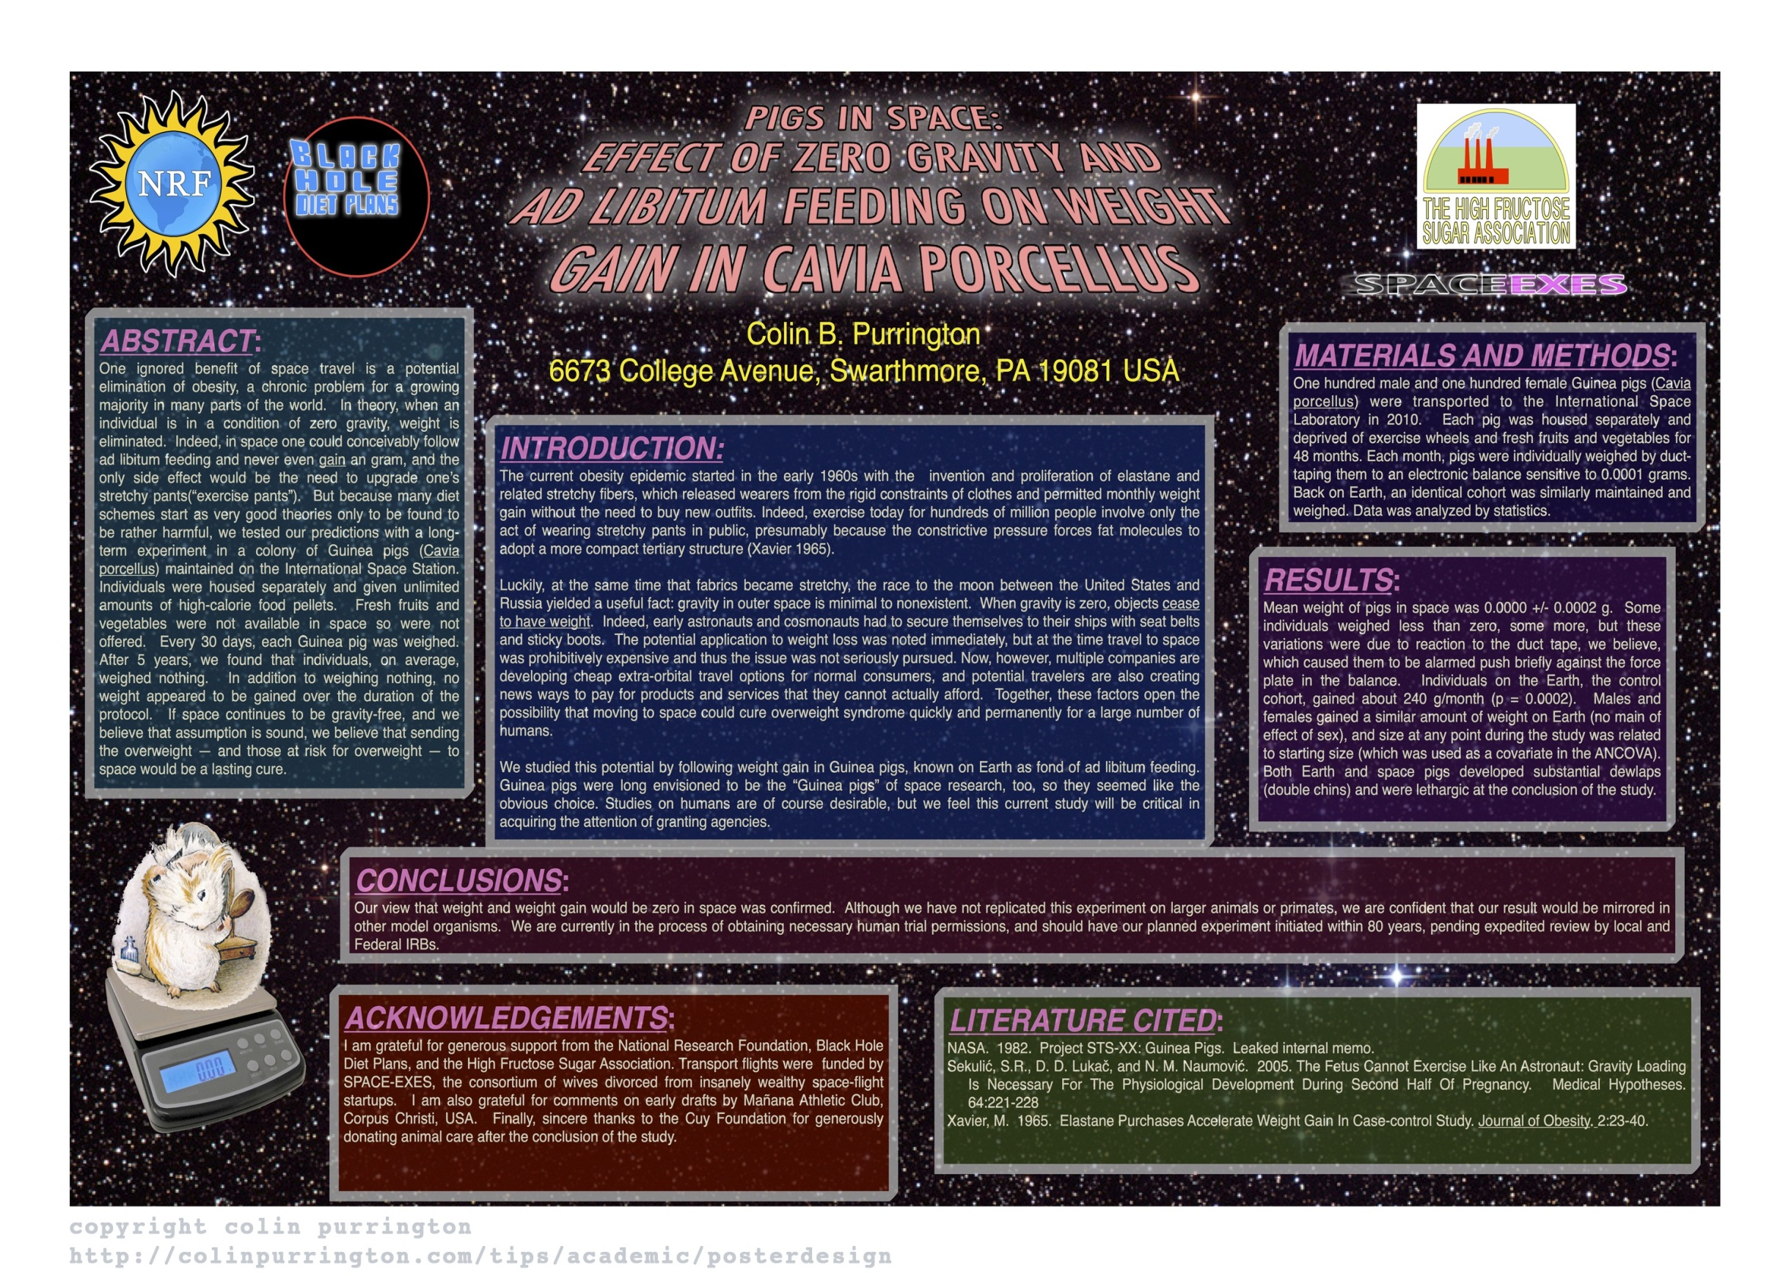
Notes:
This was specifically designed as an example of a bad poster; the text is nonsense. http://colinpurrington.com/wp-content/uploads/2012/02/bad-scientific-poster-example.jpg
Reasons why it’s bad:
Tiny font
Dark background
No data-based visuals
Lack of logical flow
6 different color backgrounds, including red and green
General obnoxiousness
And so on.

Slide 9
Introduction
Title
Background
Hypothesis
Why is this important? Why should we care?
No abstract
The poster should serve as an abstract
No blocks of text
Will a picture help?
Bullets, sentence lists
Notes:
Title: No more than two lines. Colons in the title are fine, but a little overused.
Background: Keep the background as short and as simple as possible. Remember that this is the current state of affairs in terms of research in your area, so you can include citations to other people’s work.
Hypothesis: Some people separate this out as the objective, which is also fine. Phrase your hypothesis in an interesting way; you have something important to say, so convince your reader that the research being presented on the poster is worth their time.
Abstract: Unless the conference/department requires it, don’t include an abstract. It’s redundant; an abstract is a summary of your paper, but the poster is as well. Be advised that there are differences on opinion about this.
Text: If a picture will explain your ideas better than text, you can use it instead. This is an example of how you can take advantage of the visual nature of posters; you couldn’t do this in a manuscript. Bullets and short sentence lists can help break up huge paragraphs.

Slide 10
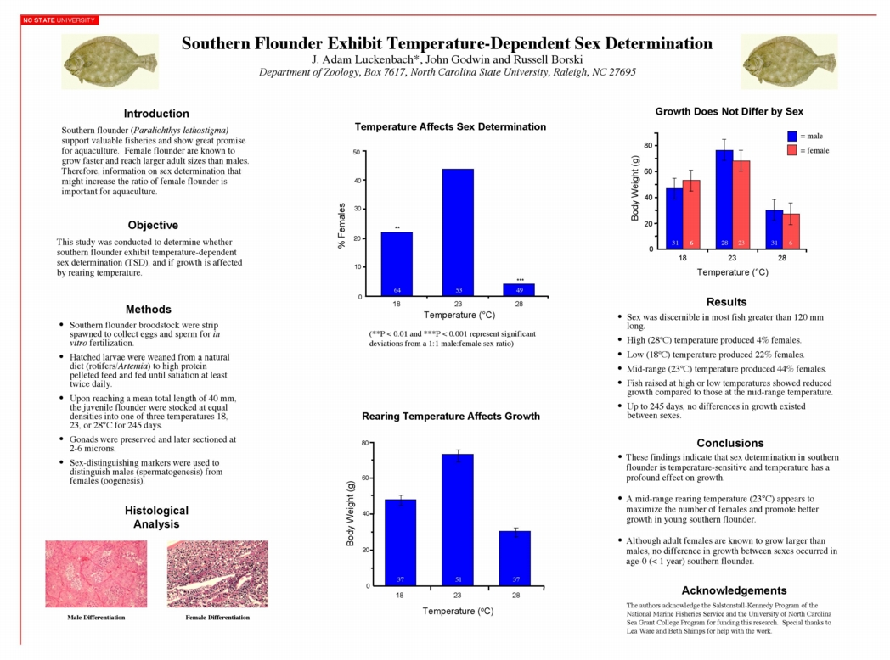
Notes:
Example: This was presented at a Zoology Department symposium at North Carolina State, where it won 1st place. http://www.ncsu.edu/project/posters/examples/Flounder/
Pros:
Clean design with lots of white space give this poster a very readable look and feel
Data is clearly presented in readable graphs
The title combined with the graphs convey a lot of information very quickly
Text is mostly broken up into bullets; while the intro and objective are in paragraph form, they’re short enough to be read quickly
The entire poster can be read in about 5 minutes
Cons:
If I wanted to ask the researchers a question about this, I would have no way to reach them
Body text is too small
As we’ll see a little later, it’s a good idea to include some questions or ideas for future research in the conclusion. Where should we go from here?
The labels for the histological analysis are a bit too small

Slide 11
Methods
Do not use the same level of detail as a paper
Use graphs, flowcharts, photographs etc.
Notes:
Tailor the level of detail to fit the audience—are they going to understand all of the terms you use, or do you need to provide definitions? If they’re members of the same field, doing similar research, you’ll want to provide more methodological detail than if they are in a different field from you.
You don’t have to list methods in words; use graphics if that’s a clearer way to present them

Slide 12
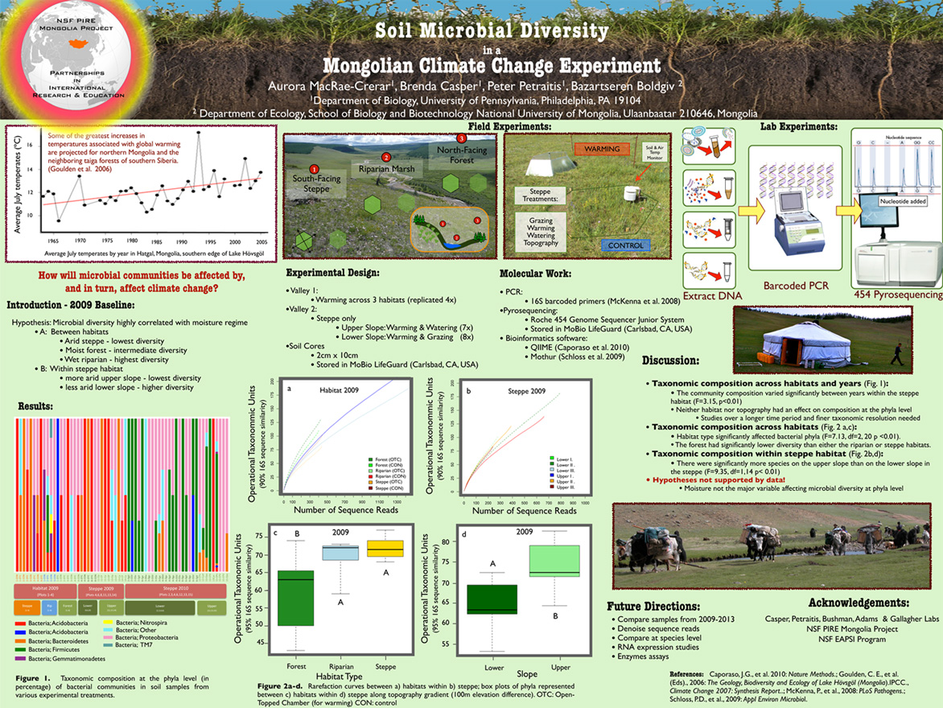
Notes:
Example:
Best Student Presentation at Argonne Soil Metagenomics Workshop. http://www.mobio.com/blog/2011/10/20/what-does-an-award-winning-student-poster-look-like/
Pros:
The question at hand is presented immediately, in a different and eye-catching font color. The reader quickly understands the general point of the research.
Text is broken down into bullets
Not too many colors in the template
Images are used to explain the methods
Use of the red font allows the reader to quickly go from the question to the answer
Cons:
Red-green is problematic
A lot of information in very little space gives this a crowded feel
Graphs are not easily read or understood
Some images feel unnecessary—do we need a picture of the PCR, or of the tent?
This would take upwards of 10 minutes to fully understand, and feels more like an illustrated manuscript than a poster

Slide 13
Results
Make sure data are readable from a distance
Give quantitative and qualitative data
Provide context and interpretations where necessary for graphs, images, etc.
Notes:
Remember that a lot of people will only look at your graphs/results, or will look at them first to see if they want to read the rest of the poster. Again, make sure all graphs, tables and so on are clean, clear and readable from a distance. This includes title axes, which should be in the same font size as your body text.
Remember that while graphs are important, they are useless if the reader can’t understand them. This arguably the most important part of your poster, so use text to explain your data if you have to.

Slide 14
Conclusion
Summarize major results
Give limitations when appropriate
Analysis of results
Questions, future directions
Notes:
Remind reader of major results without being too obvious; there’s no need for repetition.
Was your sample size small? Were there issues with your methods? This could lead to further discussion, so include it here if you think it’s appropriate.
Why should we care? What does it mean? Give some big-picture applications for your research that will help it to stick in the reader’s mind.
Again, you want to promote further thought and discussion in your readers. Where should the research go from here? What’s the next step?

Slide 15
Notes:
Example: Virginia Tech, Woods Hole, University of Puerto Rico. http://www.writing.engr.psu.edu/samples/poster7.pdf
Pros:
Color scheme is simple and very readable
Paragraphs are short
Lots of graphs and images, which are explained in the text
Text is placed centrally, so that the attention isn’t entirely focused on the images, and is large and clear
Lots of white space
Cons:
There is no way to get the point of this poster without reading the whole thing, no place where the general idea is summarized.
Graphs are much too small to be read
Some of the images feel redundant, and could have been removed to make more room for the graphs

Slide 16
Acknowledgements
Credit where it’s due
Funding
Disclosures, conflicts of interest
Cite sources
Notes:
1 & 2. Credit can go to your mentor, your lab, your PI, and to any grants, programs or other sources of funding.
3. This isn’t always necessary, but talk to your mentor and find out.
4. This is most relevant to the background information, as discussed above. Different departments have different citation standards, which should be followed exactly.

Slide 17
Notes:
Example: University of Alaska Fairbanks, won best PhD student poster at Alaska Marine Science symposium. http://www.sfos.uaf.edu/news/story/?ni=259
Pros:
Title is short and to the point; researcher includes contact info
Objectives and hypotheses are clearly stated in bulleted/numbered form
The eye flows naturally from top to bottom
Images are used to help explain methods
Future implications are clearly stated, which will promote discussion
Cons:
Size, both textually and graphically. This could be due to image compression, but even on a larger screen the body text is difficult and the graphs impossible to read.
What purpose do the pictures in the acknowledgements serve? They could have put the logos there instead, which would clean up the top of the poster.
While the background adds interest, it also distracts from the text and decreases the text-background contrast, further adding to the readability issues.
This poster will take too long to read and understand

Slide 18
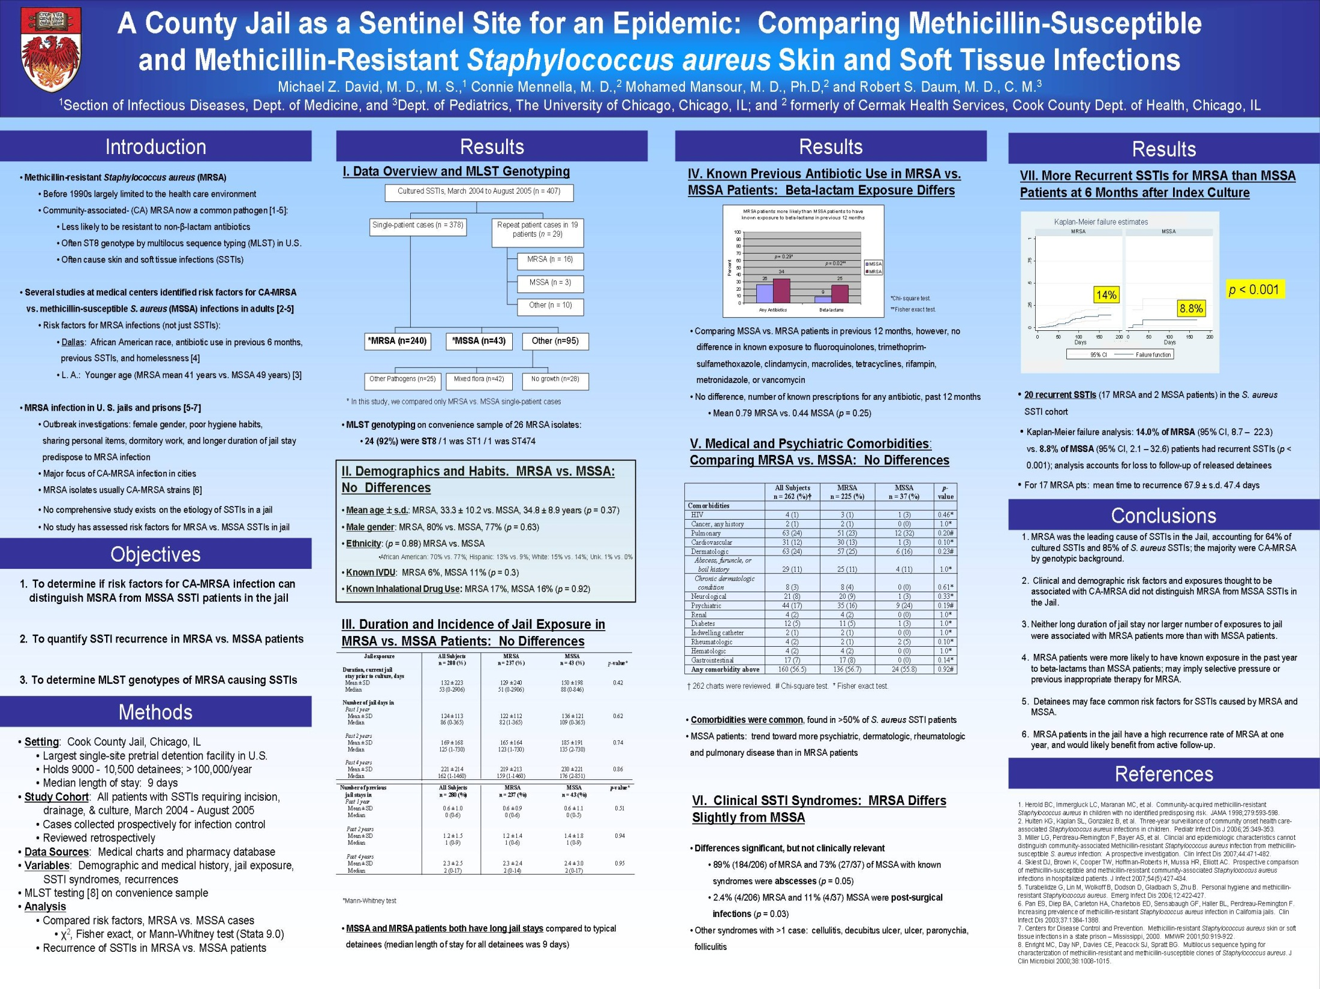
Notes:
Example: University of Chicago, presented at the Infections Diseases Society of America poster session. http://mrsa-research-center.bsd.uchicago.edu/infection_control/jail_study_poster.jpg
Pros:
The gradated background provides an interesting color scheme without being obnoxious. In general, though, background patterns are tricky and often not worth it.
All textual information is presented in short, readable bullets
Objectives are clearly and succinctly stated
Cons:
Too much information at once. If the researchers had limited themselves to just the graphs, and summarized the table data in bullet form, they could have made their graphs bigger and the poster more readable.
Avoid Excel-default graphs and tables. The bar graph is titled redundantly, and has a grey background and graph lines that decrease visibility and a key that takes up space needlessly.
The axis titles are much smaller than the body text in both of the graphs.
No further discussion in the conclusion

Slide 19
UCSF Poster Template

Slide 20
Your Poster Title Goes Here: You Can Make the Text a Bit Bigger or Smaller If Necessary
First Name Last Name, Title; First Name Last Name, Title; First Name Last Name, Title
Memory and Aging Center, Department of Neurology, University of California, San Francisco
Introduction (Helvetica)
Note: You must inform the printer that this 39” x 20” file is to be printed at 200% -- for a 78” x 40” final poster.
Before you begin, check with conference organizers for the specifications for poster size and orientation (e.g., maximum poster size; landscape, portrait, or square).
The page size of this poster template is 39” x 20” landscape (horizontal) format, due to PowerPoint limitations on slide size. Print this poster at 200%. The final size will be 78” x 40.”
How to Use This Template
Highlight the subheads, body text, or bullet items and replace by typing in your own text, or copy and paste your text from Word or PowerPoint.
Helvetica is suggested for the body text.
It’s a good idea to keep the body text / font size around this size. Since this PowerPoint slide is half the size of the final poster, this 20 point text will print as 40 points.
Keep body text left-aligned -- do not justify text. Justification can add awkward spaces to your text.
Bulleted items are easy to read. You can copy the bulleted items at the right into various places in your poster and replace the text.
Eliminate unwanted formatting from pasted text: pull down the paste options menu (it appears next to the text after pasting) and select “Keep Source Formatting.”
Revised March 2008.
Design Tips
To create a successful poster:
Simplify everything. Keep text short.
Never set whole sentences in capitals or underline; instead, use bold type sparingly.
When laying out your poster, leave plenty of breathing space around your text and images. Don’t overcrowd your poster.
Try using photographs or colored graphs.
Sample Layouts for Images & Captions
How to Add Images & Diagrams
Go through the menus as follows: Insert / Picture / From File…
Find the file on your computer, select it, and press OK.
Be aware of image size. Resolution needs to be twice what you would normally use, since the file will be enlarged 200%.
For photos, 300 dpi is a guideline. Save as TIFF or JPEG (preferably TIFF). Images containing only lines/objects (vector drawings) should be 450 dpi and saved as GIF or TIFF.
Do not use web images (resolution is too low to print well).
Graphs: You can produce graphs in Excel or directly in PowerPoint. Graphs done in a scientific graphing programs (eg. Sigma Plot, Prism, SPSS, Statistica) should be saved as JPEG or TIFF if possible. Use Insert… Object… Create from File… Browse.
PowerPoint Tips
Use View / Zoom… To zoom in a particular area, click on it, then Zoom.
Control formatting using the Paste Options menu which appears next to pasted text.
Use Shift key to select multiple elements to move (e.g., image and caption). To group selected elements, right-click, then select Grouping … Group.
If something goes wrong, Undo (Ctrl-Z) as soon as you notice.
This template is not designed for mixing different types of text within one column (e.g., body text and bullet points).
To print a proof, check Scale to Fit Paper at the bottom of the first Print dialog box. You may need to specify 11” x 17” paper in the Advanced… window, and/or which paper tray to use.
View images or other questionable areas at 200% zoom to see how they will print.
Let me know if you discover a new, useful tip!
More PowerPoint Shortcuts
Alt+F9 toggles guidelines on and off Esc de-selects all objects Alt (while dragging object with mouse) lets you move the object any increment. Control lets you move any increment while moving with arrow keys. Shift+Enter ends the line without adding vertical space for a new paragraph.
Your Conclusion Goes Here
This template was adapted from one produced by
ANR Communication Services University of California, Davis
http://anrcs.ucdavis.edu http://groups.ucanr.org/posters/Templates_for_Posters/
and from a template produced at Swarthmore College and widely reproduced online. See C. Purrington’s “Advice on designing scientific posters,” www.swarthmore.edu/NatSci/cpurrin1/posteradvice.htm (accessed 4/2007).
Remember: You must inform the printer that this 39” x 20” file is to be printed at 200% -- for a 78” x 40” final poster.
Maintain space around the logos – in this last column, do not place text inside the guides below. (The guides will not print – press Alt-F9 to view guide.)
Data and specimens used in this poster are from the National Institute of Aging UCSF ADRC AG023501.
Captions to be set in Helvetica, between 10 and 12 points (reproduced at 200%, this will be 20-24 points). Right aligned if it refers to a figure on its right. Caption starts right at the top edge of the picture, graph, or photo.
Captions to be set in Helvetica, between 10 and 12 points (reproduced at 200%, this will be 20-24 points). Left aligned if it refers to a figure on its left. Caption starts right at the top edge of the picture, graph, or photo.
Captions to be set in Helvetica, 10 to 12 points (will reproduce at 20-24 points). Set captions to the length of the column if the figure takes more than 2/3 of column width.
Notes:
This is the MAC poster layout, which you are welcome to use. What are some pros and cons to this template?

Slide 21
Geriatrics Division Poster Template

Slide 22
Division of Geriatrics Template
Notes:
Similarly, this is the poster template provided by the UCSF Division of Geriatrics. What are some pros and cons to this layout?

Slide 23
Final Notes
Conventions may vary
Know your audience
Get creative
Notes:
You don’t have to include perfectly delineated sections; you can and should change these guidelines to fit your particular research project. However, the sections described are the bare minimum and should be included in some form.
This is very important to know. Who are you going to be presenting to? Different conventions and departments have different rules, which they will often make available beforehand. Do they require an abstract on your poster? Do they have word limits or word minimums? A maximum or minimum size? Do they expect a specific layout or specific sections on your poster? You’re going to have to work within these limitations, even if they aren’t officially stated in the rules. If you’re presenting at an annual conference, one quick way to get a feel for what’s required is to look at previous years’ winning posters. It’s on you to find out about these things beforehand; good graphic design does not guarantee your poster will be successful with judges or colleagues.
Within those limits, feel free to change things up. There are plenty of templates available online, some of which can be found in the last two links on the next slide. Use one that displays your research to the best advantage.

Slide 24
Sources
Block, SM. Do’s and Don’ts of Poster Presentation. http://www.stanford.edu/group/blocklab/dos%20and%20donts%20of%20poster%20presentation.pdf
Erren, TS. Ten Rules for a Good Poster Presentation. http://chem.virginia.edu/graduate-studies/test-links-pg/how-to-make-a-scientific-poster/
Hess, G. Creating Effective Poster Presentations. http://www.ncsu.edu/project/posters/index.html
Pennsylvania State University. Design of Scientific Posters. http://www.writing.engr.psu.edu/posters.html
Purrington, C.B. Designing conference posters. http://colinpurrington.com/tips/academic/posterdesign.

