Slide 1
Approach to Research Papers
Pardis Esmaeili, B.S.
Valcour Lab Mentoring Toolbox
2015

Slide 2
Why Publish?
Lessons learned
Receive feedback
Ideas for improving practice among other professionals
Plant seeds for collaboration

Slide 3
Where to start?
Analyses Plan: Organize and Prepare
Introduction
Study Design
Statistical Considerations
Accrual and Study Completion
Demographics and Baseline Information
Primary Analyses
Secondary Analyses
Summary of major findings
Annotated Bibliography

Slide 4
Before Writing
Literature Review:
Create annotated bibliography of related literature
Create a table:
Paper | Study Design | Results/Statistical Methods | Limitations | Conclusions
Title, year, journal, first author | Sample size, procedures, tools used, timeline | Type of analyses, significant data, numbers | Small sample size? Gaps in design and implementation? | Two or three bullet points regarding significance of results

Slide 5
What to report?
Identify two or three key points
How will these points further inform clinical practice?
Unexpected results? Why?

Slide 6
The Parts: Introduction
Set the stage in 2-3 paragraphs
What’s the problem?
Discuss the previous work
What is missing from previous work?
How does your work contribute to the gaps in knowledge?

Slide 7
The Parts: Methods
Enough details to reproduce the work
Subject selection, inclusion/exclusion criteria
Tools used
Describe dependent/independent variables
Reference other studies
“We used the Geriatric Depression Scale as it’s validity has been proven in previous literature”
Use tables and figures when possible

Slide 8
The Parts: Results
Focus on objective findings:
Significance tests (ANOVA, multi-linear regression, Intra Correlation Test)
Provide p-values
Use simple and clear tables and figures

Slide 9
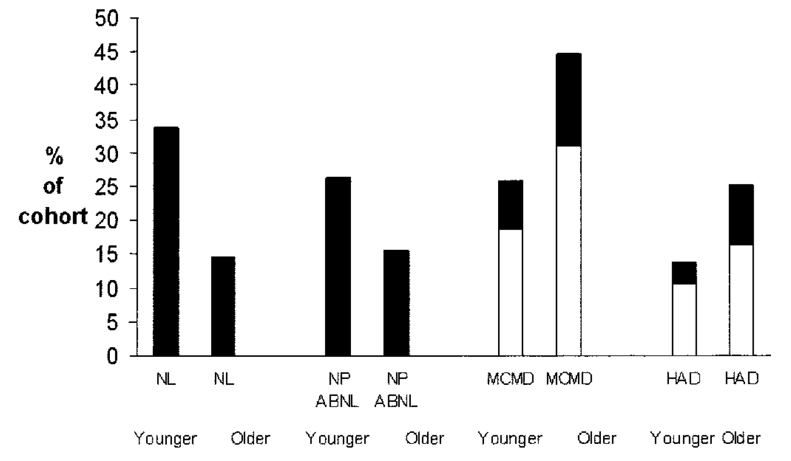
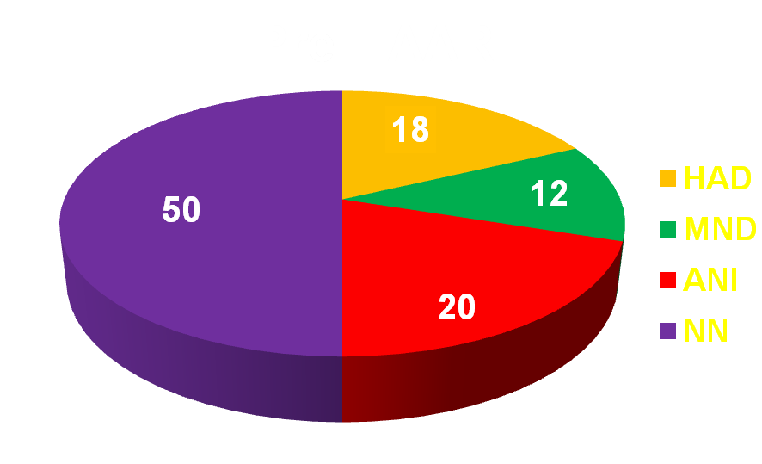
Charts and Figures
Histograms: Distribution
and Frequency of Variables
Bar Graphs: Compare different categories of data
Pie Chart: Displays parts of the whole

Slide 10
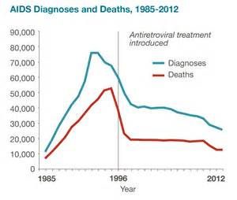
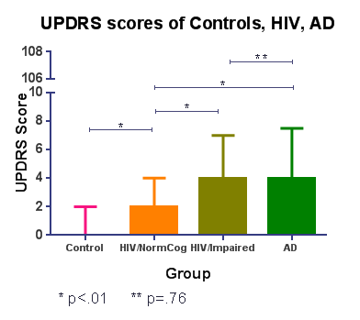
Charts and Figures
Line Plots: relationship between variables
Box Plot: Visualize center and spread of data

Slide 11
The Parts: Discussion
Summarize findings, interpret results
Describe the novelty of the work
Contradictions and similarities to previous research
Limitations

Slide 12
Finding The Right Journal
Who is the target audience of the journal?
Physicians? Neuroscientists? Radiologists? Nurses?
What is the focus of the journal?
Clinical practice? Basic Science? Clinical Research?
Has the journal published papers on similar research?
What is the journal’s impact factor?

Slide 13
Impact Factor
Demonstrates relative significance of journal within the field
Higher impact factor > higher significance
# of citations in the JCR* year
Total # of articles published in last two years
*Journal Citation Year
Notes:
Average number of times articles from the journal have been cited in the past two years in the Journal Citation Report Year (JCR).

Slide 14
Authorship
Author Responsibilities*:
Substantial contribution to conception and design, or acquisition of data, or analysis and interpretation of results
Active engagement in drafting and revising of article
Provides final approval of the version to be published
*Based on ICMJE Requirements
Strange, 2008

Slide 15
Authorship
What doesn’t qualify?
Providing funding, technical advice, reagents, samples, patient data
Providing students or technical personnel who perform studies
Routine collection of data
General supervision of research group

Slide 16
Submission
Read ‘Instructions to Authors’
Check format specifications of journal
Send draft to all authors for review
Write a cover letter to editor
Suggest preferred reviewers

Slide 17
Response to Reviewers
Read comments carefully
Be respectful when disagreeing
Address all comments
Include point by point explanation of changes
Send to authors for review
Re-run analyses if needed

Slide 18
Rejections
Common Reasons for Rejection
Repeated work
Failure to follow ‘Author Instructions’
Mismatch between paper and journal’s focus
Inadequate analyses and improper statistics

Slide 19
What to do if rejected
Don’t be discouraged
Re-run analyses or conduct additional experiments
Assess and modify statistical approach
Collect more data for larger sample size
Bolster the discussion
Consider a more appropriate journal

Slide 20
Ethical Considerations
Don’t fabricate or manipulate results
Don’t exclude negative findings
Don’t plagiarize or self-plagiarize
Include author conflicts of interest
Include funding in acknowledgements

Slide 21
Consequences of Ethical Violations
Banning authors from future publication
Placing authors on a “watch list”
In serious cases, criminal or financial repercussions
Notes:
Ethical misconduct can result in the paper being retracted from publication
Retractions can damage author credibility and make future publication difficult

Slide 22
GOOD LUCK!!

