Slide 1
Diversity and Mentorship
Pardis Esmaeili, B.S.
Valcour Lab Mentoring Toolbox
2015

Slide 2
Defining diversity
‘The variety of personal experiences, values, and worldviews that arise from differences of culture and circumstance. Such differences include race, ethnicity, gender, age, religion, language, abilities/disabilities, sexual orientation, socioeconomic status, geographic region and more.’
- UCSF Office of diversity
Notes:
People of color
LGBTI
Differently abled individuals
Undocumented immigrants

Slide 3
Faces of diversity: Underrepresented minorities (URM)
‘Racial and ethnic populations that are underrepresented in the medical profession relative to their numbers in the general population’ (AAMC)

Slide 4
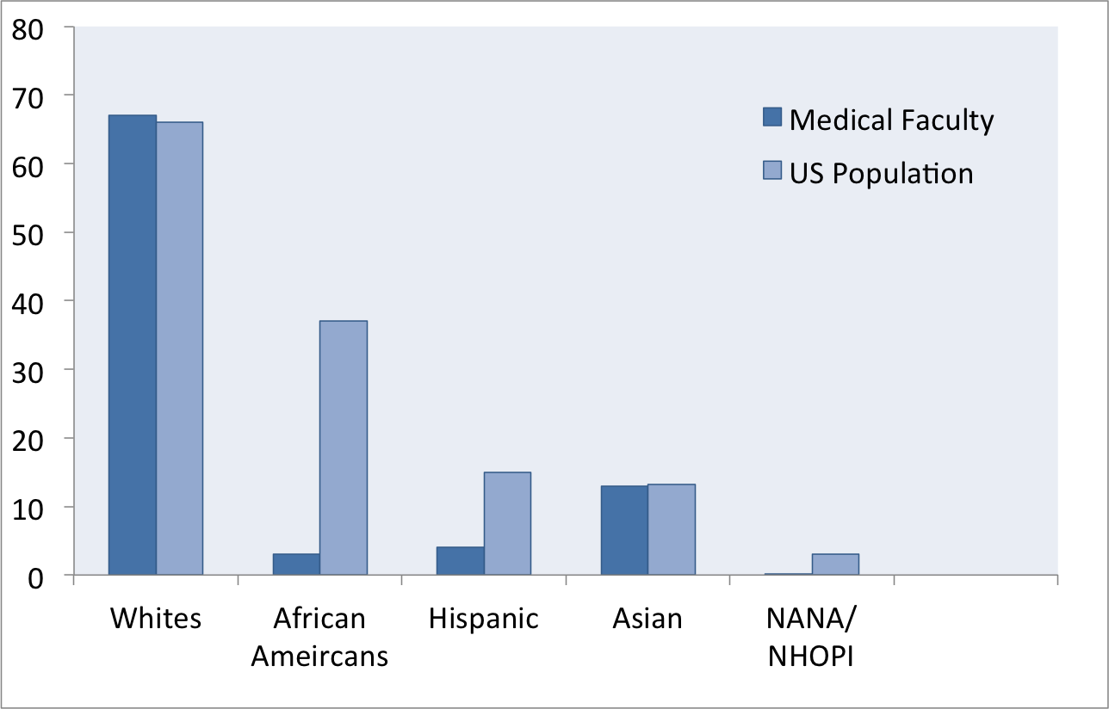
US Race/Ethnicity Percentages: Population versus Medical Faculty
*
*Native American, Native Alaskan/Native Hawaiian and other Pacific Islander
Adapted from Merchant, 2009

Slide 5
Gender Inequities
Leadership at U.S. Medical Schools by Gender, 2008
Leadley, 2009

Slide 6
UCSF Race Distributions
2014 UCSF Campus Climate Project Final Report, Rankin & Associates Consulting
Notes:
Based on respondents of UCSF’s Campus Climate Survey, 2014

Slide 7
US born versus Immigrant Under-Represented Minorities
Influence of race on self-view shaped by country of origin:
Those born in US tend to face discrimination earlier in life
Impacts opportunities to education, self-view and external biases
Merchant, 2009
Notes:
A recent report of interviews from 25 African-American physicians, including 2 black physicians:
African-Americans, Latinos, and Native Americans experienced bias and discrimination due to skin color and ethnicity early enough that it impacted their educational opportunities, view of them-selves, and external biases from others. (Nunez-Smith, 2007)
This is not necessarily the case for Africans or immigrants who have migrated to the US later in life, in high school, for example.

Slide 8
Beyond race and ethnicity
‘People with disabilities, people from disadvantaged backgrounds, and racial and ethnic groups such as blacks or African Americans, Hispanics or Latinos, American Indians or Alaskan Natives, and Native Hawaiians and other Pacific Islanders’ (NIH)
Notes:
African American
Hispanic or Latino
Physically or developmentally impaired students have limited capacity to fully participate in all educational experiences
Leaving them out of opportunities to connect with, form social groups and networks, and establish community within the educational setting leading to isolation and the psychological difficulties arising from isolation

Slide 9
A National Call for Diversity
NINDS Advisory Panel for Workforce Diversity
NIH Working Group on Diversity in the Biomedical Research Workforce
ADA Diversity Mentoring Project
National Advisory Mental Health Council Workshop on Research Training

Slide 10
The pearls of diversity
Improved ability to address health disparities (Forsyth, 2009).
More accurate representation of the general population (Forsyth, 2009; Merchant, 2010) .
Higher rate of patient satisfaction with health-care (Merchant, 2009)
Wider range of perspectives that can contribute to more innovative and collaborative solutions (Forsyth, 2009).
Increase pool of role models for younger under-represented minorities (URM) (Merchant, 2009; Tabak, 2011).
Notes:
“Investigators from underrepresented racial/ethnic groups who are verse in community norms and values, can bring insights to bear on key issues affecting community health, and can make innovative contributions to the field that benefit all of society” (ADA, 2003)
Diverse workforce can improve public health of those at increased risk for preventable morbidity and mortality
Hispanic and African-American patients who receive are from a physician of Hispanic or African-American ethnicity rated higher satisfaction of health care (Saha, 2009)
In 2006, African Americans, Lations and American Indians accounted for 27.8% of US population, but only 12% of doctorate recipients
It is predicted that by 2050, nearly 50% of US population will be non-white or a person of color (American needs a more diverse physician workforce, AAMC; More diversity, slower growth, US Census Bureau)

Slide 11
Challenges to Diversity
Institutional level
Leaks in the development pipeline
Disparity in funding and promotions
‘Token’ phenomenon (retention barrier)
Decline in traditional funding for new investigators
Lack of dedicated time and compensation for mentoring efforts

Slide 12
Percentage of Under-Represented Minorities Across the Educational Ladder*
*Data from 2005
** Science, Technology, Engineering, Math
Adapted from Chubin, 2007

Slide 13
Funding & Promotion Disparities
Black grant applicants 10% less likely to receive NIH funding than white applicants (Ginther, 2011).
URM faculty less likely to be promoted compared to white faculty (Fang, 2010).
Disproportionate number of women at professor rank across ethnicities compared to men (Merchant, 2009).

Slide 14
Challenges to Diversity
Individual level
Barriers to access, financial constraints (from early childhood)
Lack of knowledge about medical field
Limited encouragement at home
Negative peer pressure
Lack of role models
Racism in medicine
‘Token’ Phenomenon (isolation) – unwelcoming environments
Negative mentoring experiences
Difficulties of low and unstable salaries associated with research careers
Merchant, 2009; Tabak, 2011; Thomas, 2007 ; Forsyth, 2009

Slide 15
Possible Solutions
Stable funding for mentorship
Partnerships
Monitoring and evaluating progress
Dedicated mentoring programs
Changing academic paradigms
Team mentoring
Forsyth, 2009
Notes:
Stable funding- for meetings, training, research mentorship
Partnerships- between well-funded research institutions and minority serving educational institutions
Monitoring and evaluating- progress toward recruitment, retention and promotion of URM students and faculty
Dedicated mentoring programs- with efforts to recruit from URM pools
Changing academic paradigms- exploring alternate approaches that reflect unique perspectives and experiences of URM individuals and their contributions to science

Slide 16
Defining Mentoring
“A process in which an experienced individual (a mentor) acts as a role model and guide for a less experienced person (mentee) specifically advising he or she in academic, personal, and/or professional aspects of their lives.”
Mondisa, 2014

Slide 17
Mentor Qualities
Personal | Professional
Compassionate | Collaborative
Enthusiastic | Intellectual
Generous | Skilled
Honest | Teacher
Insightful | Communicative
Selfless | Accessible
Wise | Visible
Cho et al, 2011

Slide 18
Mentor Roles
Psychosocial Support: to develop sense of competence, confidence, and effectiveness.
Career Support: to learn to navigate the professional world and create opportunities for growth.
Kram et al, 1983

Slide 19
Mentoring To Promote Diversity
Enhances career development, success and satisfaction (Palepu, 1996: Kosoko-Lasaki, 2006).
Especially important for URM who face numerous obstacles to achieving academic success (Merchant, 2010).

Slide 20
Considerations for mentors
Willingness to discuss psychosocial factors affecting mentee
SES disadvantages
Discrimination and racial profiling (Black Lives Matter)
Isolation
Background of mentee and how that informs their decision to pursue research career
Mentee Research interests
Notes:
Psychosocial:
Current race climate around Blacks in America can affect Black mentee’s sense of safety and worth to society. Triggering events of shootings and harassment can accumulatively affect mentee’s psychological ability to handle stress and criticism in their own life.
Economic disadvantages leading to lack of access to quality schools and education and development resources

Slide 21
Cultural Competence
Cultural Variations in:
Eye contact
Handshake
Tone of voice
Comfortable physical space
Inclusion of new person in group
Greeting strangers (on street)
Direct vs. indirect responses to difficult questions
Treatment of elders (forms of address)
Values and attitudes regarding gender roles
Family Values
Food habits
Others

Slide 22
Implicit Bias
Biases that are somewhat unconscious and automatic in so far as they execute behavior without conscious intention (adapted from Byrne, 2014)
‘Non conscious stereotyping’ (negative or positive)
Notes:
Examples:
Assuming chaotic lifestyle based on someone having tattoos
Presence of drug abuse in an African American individual
Women and lack of mathematical ability
Black men and athleticism

Slide 23
Combating implicit bias
Acknowledge and accept
Projectimplicit.com – Harvard University
Constant discussions in the workplace
Engage in correcting through forming new, more accurate associations

Slide 24
Tips for URM mentees
Look for programs targeted toward URMs
Questions to consider:
What type of personality are you most comfortable with?
What do you hope to gain from this relationship
What do you hope your mentor gains from this relationship?
Does targeted mentor/institution have history of working with URM? (A diversity office, diversity statement)

Slide 25
Tips for URM mentees
Actively seek out mentors and diverse pool of advisors
Identify and utilize available resources
Regular self-assessments
Engage with other URM
Join associations dedicated to URM
Notes:
Regular self-assessments to evaluate existing skills, areas in need of improvement, opportunities for building new necessary skills
Engage with other URM- peer mentoring and support in order to alleviate sense of isolation and tokenism

